Slide 1
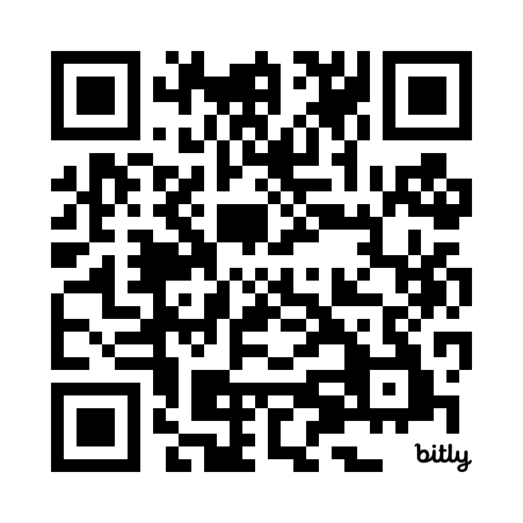
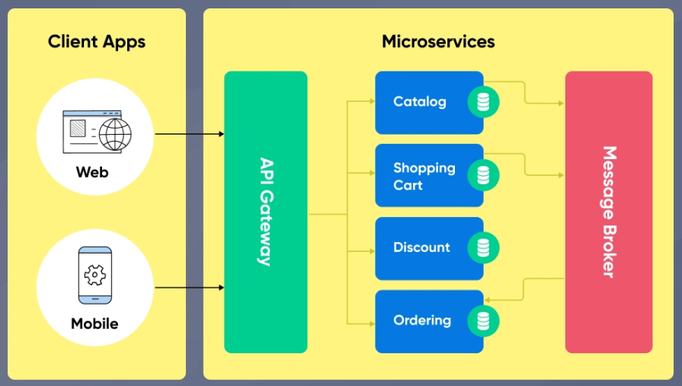
Lab 01 - Microservices
https://bit.ly/3FfOjCO

